Slide 1
Pheochromocytoma and Paraganglioma
Management of Hormonal Manifestations
Camilo Jimenez Vasquez
Professor
Department of Endocrine Neoplasia and Hormonal Disorders
The University of Texas MD Anderson Cancer Center

Slide 2
Outline
Introduction
Anatomical definitions
Clinical manifestations
Treatment
Hypertension and prevention of cardiovascular complications
Gastrointestinal disease

Slide 3
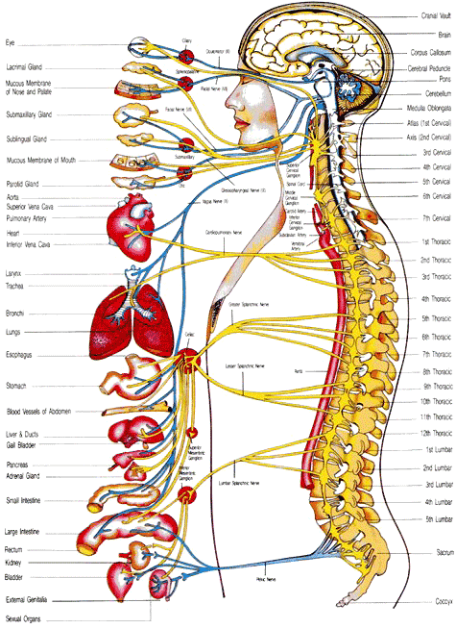
Paraganglia
Group of neuro-endocrine cells that migrate during embryonic development with components of the parasympathetic and sympathetic ganglia.
Notes:
3

Slide 4
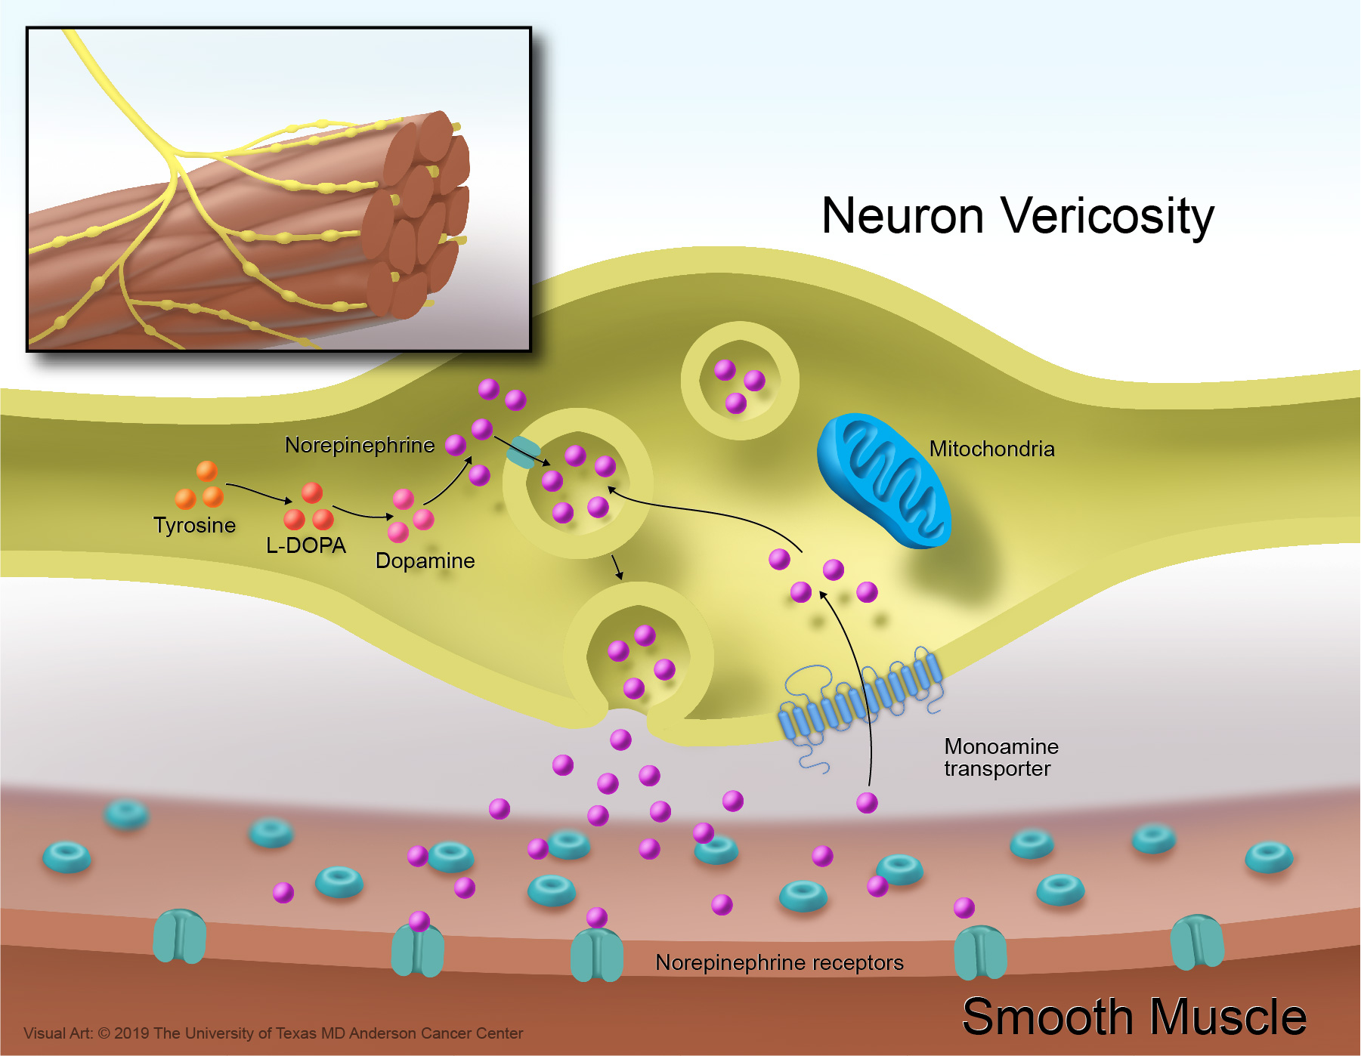
Catecholamines are the hormones of stress
They are the hormones we use to escape and/or fight

Slide 5
Pheochromocytomas
Chromaffin (+) tumors originated in the adrenal medulla. They may produce catecholamines such as epinephrine and/or norepinephrine predisposing to cardiovascular disease and other complications.
WHO 2017
Notes:
5

Slide 6
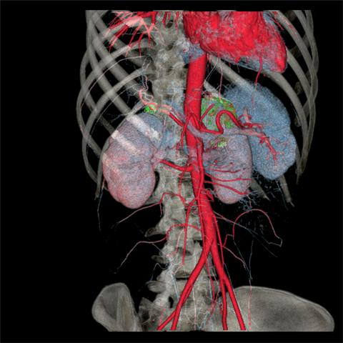

Slide 7
Paragangliomas
Paragangliomas are tumors that arise from extra-adrenal chromaffin cells and can originate either in the parasympathetic or sympathetic ganglia.
Parasympathetic: chemodectomas, carotid body tumors, glomus jugular tumors, etc.
Sympathetic: thoracic, abdominal, and pelvic tumors. They may produce norepinephrine and/or dopamine predisposing to cardiovascular disease and other endocrine complications
WHO 2017
Notes:
7

Slide 8
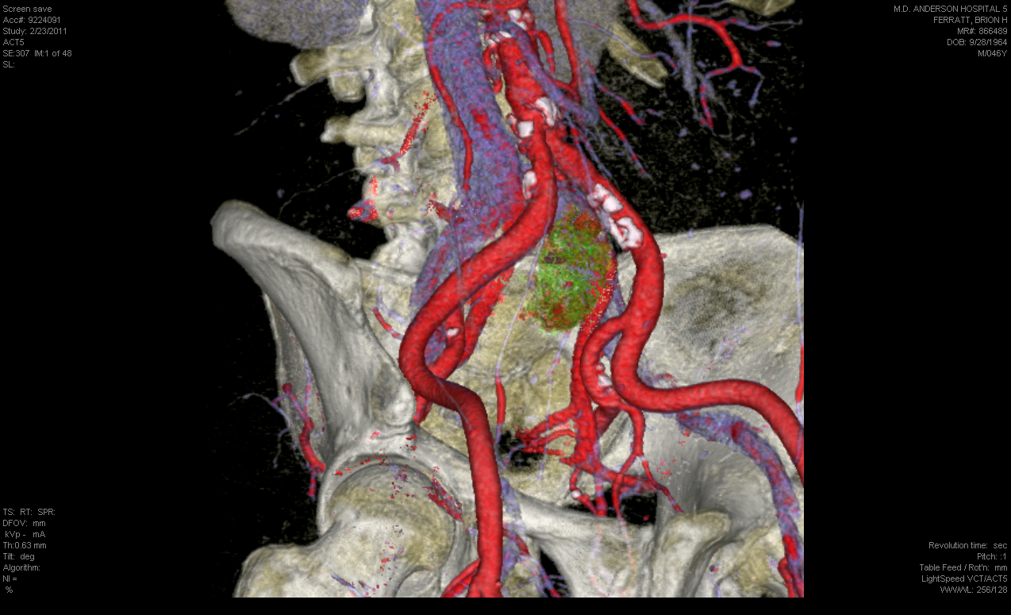

Slide 9
Clinical manifestations
Symptom | Frequency %
Headaches | 60-90
Palpitations | 50-70
Diaphoresis | 55-75
Pallor | 40-45
Nausea | 20-40
Weight loss | 10-20
Flushing | 20-40
Fatigue | 20-40
Anxiety – Panic attacks | 25-40
Sustained hypertension | 50-60
Paroxysmal hypertension | 30
Orthostatic hypotension | 10-50
Lenders, Lancet 2005

Slide 10
Prevention of complications

Slide 11
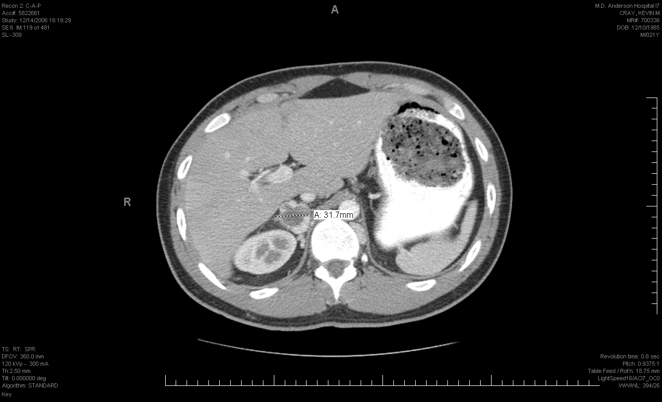
Back pain
Throbbing hedaches
Diaphoresis
Palpitations
Blood pressure 137/65
Normetanephrines = 2300 NG/ML (<400)
Metanephrines are normal
Von Hippel Lindau
Rich, Cancer Investigation, 2008

Slide 12
Surgery may provoke a release of catecholamines
Drugs/Procedure | Details
Procedure | Mechanic intubation, peritoneal insufflation, tumor palpation
Opiates | Thiopental, nalbufine, meperidine, morphine
Neuromuscular Blockers | Tubocurare, succinilcoline, mevacurio, atracurio
Tranquilizers and antiemetics | Metoclopramide, droperidol
Simpaticomimetics | Efedrine
Vagolitics | Atropine

Slide 13
Organ | Receptor | Physiological Effect | Symptom
Arterioles
Coronary | Alpha-1 | Contraction | Angina
Skin and mucosa | Alpha-1 | Contraction | Pallor
Skeletal muscle | Alpha-1, Beta-2 | Contraction, dilation
Cerebral | Alpha-1 | Contraction | Stroke
Pulmonary | Alpha-1 | Contraction | Pulmonary edema
Abdominal Viscera | Alpha-1 | Contraction | Intestinal ischemia
Renal | Alpha-1 | Contraction | Renal failure
Veins | Alpha-1, Beta-2 | Contraction dilation | Orthostatism
Heart
SA node | Beta-1 | ⌂ Inotropism | Angina, arrhythmias
Atrium | Beta-1 | ⌂ Inotropism | Angina, arrhythmias
AV node | Beta-1 | ⌂ Inotropism | Angina, arrhythmias
His-Purkinje | Beta-1 | ⌂ Inotropism | Angina, arrhythmias
Ventricle | Beta-1 | ⌂ Inotropism | Angina, arrhythmias

Slide 14
Impact of alpha-blockage on surgical outcome
Goldstein, Annals of Surgery, 1999

Slide 15
How to choose the alpha-blocker?

Slide 16
Alpha-blocker | Type | Dosage | Half-life | Side effects | Availability/ Monthly Price
Phenoxybenzamine | Non-selective, non-competitive | 10 – 140 mg/daily | 10 days | POP persistent Hypotension, reflex tachycardia, nasal congestion Edema | Difficult to get in many countries US 61.00- 1500
Prazosin | Alpha-1 competitive | 1-16 mg/daily | 3- hours | Orthostatism, tachycardia | Easy to find/ US 13.00
Terazosin | Alpha-1 Competitive | 1-48 mg daily | 24 hours | Orthostatism, tachycardia | Easy to find/US 4.00
Doxazosin | Alpha-1 Competitive | 1-48 mg daily | 24 hours | Orthostatism, tachycardia | Easy to find/US 20.00

Slide 17
Beta-blockers
They should be initiated once the patient develops orthostatism and/or reflex tachycardia which indicate that alpha blockage has been obtained.
Selective: Metoprolol, Atenolol
Non-selective: Propranolol
Labetalol and Carvedilol

Slide 18
Calcium Channel Blockers, ACE inhibitors, Angiotensin Receptor Blockers
Indications:
Mild cases (e.g. small tumors identified by radiographic screening in patient with hereditary predisposition) or unable to tolerate alpha-blockers
As a supplement to alpha- and beta-blockers when BP is still difficult to control
As a supplement to alpha- and beta-blockers in order to prevent toxicity associated with higher doses

Slide 19
Metyrosine
Tyrosine hydroxylase inhibitor
It decreases catecholamine secretion
It has side effects that frequently prevent the use of effective doses: fatigue, depression, anxiety, diarrhea
Price > US 1000

Slide 20
How long it takes to prepare someone for surgery?
7-14 days
At MDACC the average time is 8 days thanks to communication with the patient daily and frequent drug adjustments
There is no need to admit the patient to the hospital or to use metyrosine.
The patient should have a normal salt diet and free water intake. IV fluids may be necessary before surgery.

Slide 21
Gastrointestinal complications

Slide 22
Case
46 year-old man with a metastatic paraganglioma complains of hypertension, palpitations, headaches, sweats, and constipation. Constipation has been present for longer than one year. Last bowel movement was hard and occurred one week ago. The patient lacks of appetite. He complains of nausea and fever.
Creatinine and WBC are elevated
Plasma normetanephrines: 49.5 nmol/L (<0.90)
Thosani, EJE, 2015

Slide 23
Case
Thosani, EJE, 2015

Slide 24
Severity of constipation
Grade 1: Occasional or intermittent symptoms
Grade 2: Persistent. It requires laxatives and impairs regular activities (driving, seating)
Grade 3: Manual evacuation is required
Grade 4: life-threatening
Grade 5: Death

Slide 25
Constipation
6% of patients with pheochromocytoma and paraganglioma have it.
It is usually mild; occasionally, it is severe
It predisposes to hemorrhoids, stercoral ulcers, bleeding, perforation, obstruction, malnourishment, and toxic megacolon.
Alpha- and beta-blockers do not treat constipation
It is preventable with a diet rich in fiber and liquids
Thosani, EJE, 2015

Slide 26
Treatment
Grade 1 and 2
Diet with fiber, liquids, and warm beverages
Stimulant laxatives (docusate) and stool softeners (senna);
Add milk of magnesia and/or mineral oil if the previous measures do not work
Grade 3 and 4
Mineral oil, magnesium citrate, milk and molasses enemas. Do not use normal saline enemas.
Polyethylene glycol
Hydration with normal saline
Thosani, EJE, 2015

Slide 27
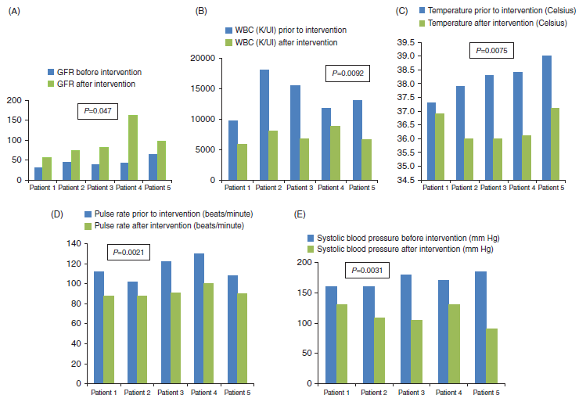
Treatment
Thosani, EJE, 2015

Slide 28
Patients’ tasks
To check blood pressure and pulse periodically
Goal: to keep blood pressure always normal
To follow a diet rich in fiber, warm beverages, good hydration, and normal salt content
Goal: to prevent constipation and keep hydration

Slide 29
Conclusions
Patients with pheochromocytomas and pargangliomas are prone to develop endocrine complications
Endocrine complications are preventable and treatable
Expertise and common sense are very important to treat these patients

Slide 30
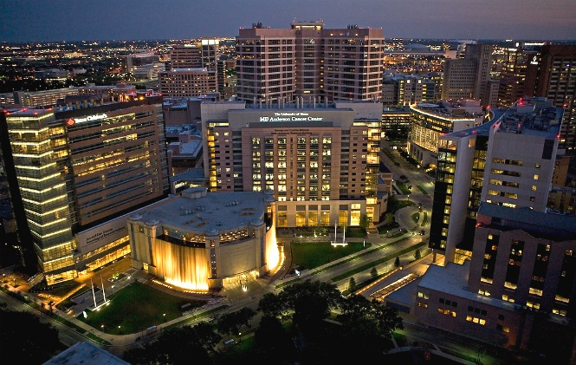
cjimenez@mdanderson.org

Slide 31
Most serious problems
Organ | Complication
Heart | Arrhythmias, heart attacks, angina, hear failure
Lungs | Pulmonary edema
Kidneys | Renal failure
Eyes | Retinopathy
Intestines | Ischemia, constipation
Brain | Strokes

